Slide 1
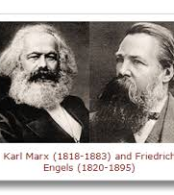
The Communist Manifesto 1848
Karl Marx and Friedrich Engels
The Manifesto is one of the world’s most influential political documents

Slide 2

“Workers of the World Unite!”
You have nothing to lose but your chains
A call to revolution

Slide 3
Theory of Social Change
Communist Manifesto conceptualizes a theory of social change
It is the conflict between classes that results in social change
"The history of all hitherto existing society is the history of class struggles.”

Slide 4
Stages of history according to Marxist theory
Primitive Communism
Feudalism
Capitalism
Communism

Slide 5
How history moves
The economic organization of society
Forces and means of production - The forces of production refer to both the material worked on and the tools and techniques employed in the production of economic goods.
Means – land, labour, capital

Slide 6
contd
Relations of production
The relationships of production refer to the social relations arising in the process of production, especially between the owners and non-owners of the means of production.

Slide 7
Base and Superstructure
From the base (forces, means, relations of production) comes a superstructure in which laws, politics, religion and literature legitimize the power of the social classes that are formed in the base.

Slide 8
Class struggles through history
“Freeman and slave, patrician and plebian, lord and serf, guild master and journeyman, in a word, oppressor and oppressed stood in constant opposition to one another, carried on an uninterrupted fight…a fight that ended each time in a revolutionary reconstitution of society at large, or in the common ruin of the contending classes.”

Slide 9
Communist Manifesto
In 1847 when the Communist Manifesto was written, socialism was a middle class movement and communism was a working class movement.
Emphasized the necessity of total social change not merely political revolutions.

Slide 10
Classes and class antagonisms
“The modern bourgeois society that has sprouted from the ruins of feudal society has not done away with class antagonisms.
It has but established new classes, new conditions of oppression, new forms of struggle in place of the old ones.....

Slide 11
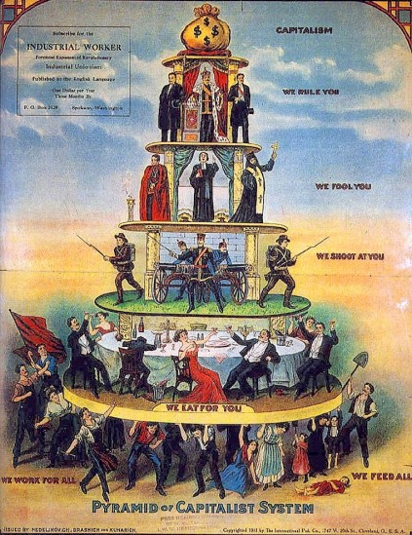
The Capitalist System

Slide 12
Bourgeoisie
The rise of capitalism and the capitalist class (owners of the means of production and employers of wage labour)
“The modern epoch has simplified the class antagonisms”
“Two great classes – the bourgeoisie and proletariat - remain”

Slide 13
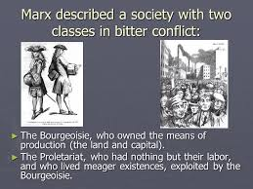
Bourgeoisie and Proletariat

Slide 14
Contd.
Decline of guilds
Rise of the manufacturing middle class
Steam and machinery revolutionized industrial production
Growth of the bourgeoisie – “the executive of the modern state is but a committee for managing the common affairs of the whole bourgeoisie” (state/government and business in cahoots with each other)

Slide 15
Money as the predominant medium of exchange
Capitalism puts an end to all feudal, patriarchal, idyllic relations.
Everything is measured in money terms –
“It has converted the physician, the lawyer, the priest, the poet and the man of science, into its paid wage labourers.”

Slide 16
The Profit Motive
The bourgeoisie must constantly revolutionize the instruments of production and thereby the relations of production.
“The need for a constantly expanding market for its products chases the bourgeoisie over the surface of the whole globe.”

Slide 17
The advent of globalization
Gives a cosmopolitan character to all products, taking away their national/regional character.
Materials drawn from all over; consumption irrespective of the location of production
Compels all nations to adopt the bourgeois mode of production.

Slide 18
Urban over rural
Bourgeoisie subjects the country to the rule of the towns.
Rescues people from the ‘idiocy of rural life’.
It has agglomerated population, centralized means of production and has concentrated property in a few hands.

Slide 19
Contradiction
Contradiction between the forces and the relations of production
The old relations of prod – such as of feudalism no longer suit the new capitalist production systems - they become fetters on its development
This contradiction leads to the emergence of a new system.

Slide 20
Characteristics of the Capitalist System
The profit motive
Free competition
Wage labour

Slide 21
Mechanisms of capitalist production
Use value
Exchange value
Surplus value (where profits come from; the creation of capital)
Subsistence for the labourer and reproduction of new labourers

Slide 22
Rise of the proletariat
The modern working class, developed — a class of labourers, who live only so long as they find work, and who find work only so long as their labour increases capital.
Exploitation of the proletariat
Alienation of the worker – man an appendage of the machine

Slide 23
Contradictions and crises
Crisis of capitalism
Revolt of modern productive forces against modern conditions of production(exploitative), against the property relations that are the conditions for the existence of the bourgeoisie and its rule.
Commercial crises – that put the existence of the entire bourgeois society on trial each time more threateningly.

Slide 24
The working class movement
All previous historical movements were movements of minorities, or in the interest of minorities.
The proletarian movement is the self-conscious, independent movement of the immense majority, in the interest of the immense majority.”
From a national struggle it grows into a universal struggle.

Slide 25
Special character of the proletariat
Of all the classes that stand face to face with the bourgeoisie today, the proletariat alone is a really revolutionary class.
The other classes decay and finally disappear in the face of Modern Industry; the proletariat is its special and essential product.

Slide 26
Communism
The theory of the Communists may be summed up in the single sentence:
Abolition of private property.

Slide 27
Spread of Communist ideology
Marx’s ideology influenced the course of history
Overthrow of bourgeoisie by the proletariat
Two major experiments with Communism
Russia and China

